Slide 1
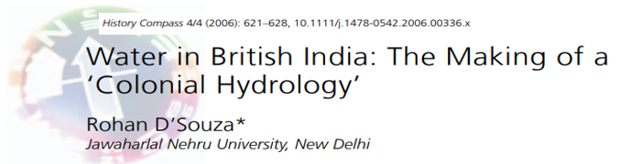
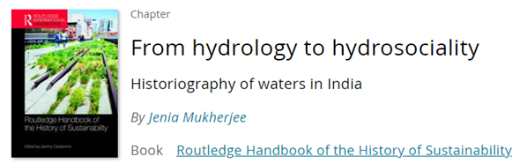
What is ‘colonial hydrology’?
Did the British experience comprise of an altogether distinct paradigm for hydraulic interventions in South Asia?
Notes:
Relationship between colonialism and water
much insight and theoretical traction may be gained from pursuing the conceptual notion of a ‘colonial hydrology’: the attempt to characterize the British experience as comprising an altogether distinct paradigm for hydraulic interventions

Slide 2
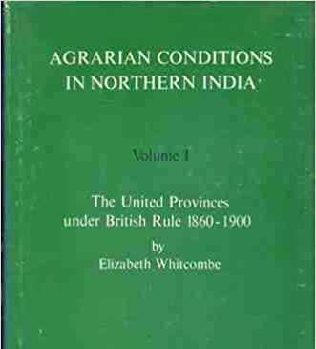
North India
NWFP
replacement of traditional well irrigation system
impact of perennial irrigation had an adverse effect on the environment and the peasantry
  saline deserts, waterlogged swamps, and decreased soil fertility
  rich landlords - distribution channels; collection of water tax
depressed peasantry laboured in a distorted environment (xi)
Notes:
Elizabeth Whitcombe's Agrarian Conditions in Northern India could be considered the first attempt to highlight the profound differences between pre-colonial and colonial water regimes. Drawing from a vast bibliography of government records on agriculture, famine, finance, railways, revenue, public works, trade, law, and especially the comprehensive land-revenue settlement reports for each of the nearly 40 districts covering United Provinces of Agra and Oudh (present day Uttar Pradesh), Whitcombe explored how the introduction of perennial irrigation had an adverse impact on the environment and the peasantry. The new hydraulic experiments, heavily underwritten by commercial principles led to saline deserts, waterlogged swamps, and decreased soil fertility. She examined how more reliance on large-scale water storage systems and lengthy diversion channels replaced and uprooted the traditional well irrigation system which was more dependable in the semi-arid region with low rainfall. Her work also studied power relations and the nexus involved in distribution and access to irrigation water and collection of water tax; rich landlords controlled the layout of distribution channels and local agents who collected water charges followed extractive means burdening peasants who were already suffering from ecological problems. Whitcombe illustrated in detail how a "depressed peasantry laboured in a distorted environment“ (xi).

Slide 3
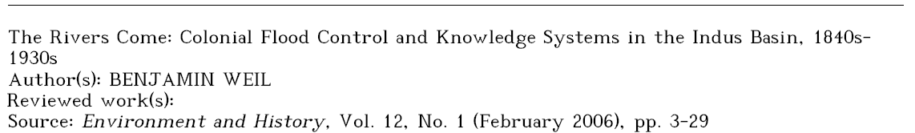
colonial flood control in the Indus valley (Dera Ghazi)
conflict between the local knowledge-based approach and technological mentality of engineers
  Complex engineering works replaced traditional warning systems and mobility, undermining alluvial farming systems as well as a precautionary approach to environmental management.
Notes:
This essay traces the development of the physical and cultural infrastructure of colonial flood control in the Indus valley. Reconstructing investigations into the causes of a series of floods illustrates the conflict between the idiosyncratic, local knowledge-based, approach of generalists and the reductionist, technological mentality of engineers. Repeated attempts to protect towns from the Indus River illustrate the growing dominance during the second half of the nineteenth century of an engineering mentality, despite its practical shortcomings. Complex engineering works replaced traditional warning systems and mobility, undermining alluvial farming systems as well as a precautionary approach to environmental management.
For the British who had just conquered Sindh, 'the changeable nature of the river' was primarily an impediment to navigation.
The shifting and flooding of the Indus valley rivers continued to have significant implications for public works efforts in irrigation, transportation, flood protection, and even schemes to re-direct rivers into channels that better suited the convenience of government.
Of course, the river system did not begin its wandering ways with the arrival of the British. People had occupied the valley for millennia and developed techniques, traditions and institutions that allowed them to farm the alluvium, graze animals in the hills, trade up and down the river, and avoid the worst effects of its periodic floods. The first British officers who came to manage the country depended on their relationships with local authorities for understanding and intelligence about the unpredictable Indus. An examination of the approaches to dealing with and ascertaining the cause of floods reveals significant changes in attitude over time toward nature and local knowledge.
Floods – 1841, 1858 – Dera Ghazi
Henderson - cited universal laws that regulate the motion of glaciers; Arthur Cotton, “A Delta is a Delta all over the World”.
The chief approach for avoiding the negative impacts of flooding was avoiding the floodwaters. Cultivation was restricted to a 3 to 15 mile wide strip on either side of the River. During the rabi, almost every alluvial or hithar acre was brought under cultivation without any need for irrigation. Jangli cultivators also arranged temporary systems of dams, channels and embankments to irrigate the nakka portion of the cultivation zone lying outside the area fertilised by inundations.54 They grew a wide array of crops that ripened at different rates, required different levels of irrigation, or complemented each other in the growing season.55 During the extremes of flood and dry, these same Janglis engaged in semi-nomadic pastoralism well suited to the sparse vegetation of the doabs.56 While this ran counter to the British interest in consistent revenue assessments and settlement that lay behind most perennial irrigation schemes57, the workability of the system for the Janglis themselves was apparent to some British observers.58 Close embanking of the Indus may have protected irrigated fields and garrison towns, but it contributed to the decline of sailab cultivation in western Punjab.
Perhaps the most important flood avoidance technology was a social technology of communication. People living high up in the mountains communicated regularly to those downstream about the likelihood of flooding. Due to the multiple possible causes of floods, the only viable strategy for prediction was for those residing near the site of a natural dam (whether caused by landslide, glacier, or avalanche) to warn villages farther downstream and keep them ap prised of the condition of the blockage. Traders, herders, doctors, newswriters and teachers formed a communication network linking villages and towns up and down the Indus and its tributaries and carried these warnings along with other news. The authenticity of these warnings depended on the social technology of relationships; kinship, clan connections and positions of respect leant credibility and urgency to the warnings.
How different this is from the engineering approach typified by Henderson! After all, warnings were comparatively cheap and could be assured through relatively simple arrangements between government agents and local authorities. Embankments and river training diversions required unprecedented expenditure and technological expertise that never sufficiently developed until the 1930s.
The answer has a lot to do with the culture of science that rose to absolute prominence in the second half of the nineteenth century. Science had transformed the unknown into the yet-to-be-known.67 British technological superiority not only enabled British rule over non-Europeans but provided an ideological legitimisa tion for it as well.68 In addition, the British preference for settled agriculture was incompatible with a system that respects the vagaries of a river like the Indus. The flexibility and mobility necessary for a system of dealing with flooding by forewarning and evacuation implies a mixed economy typical of sailaba agriculture and the nomadic pastoralism of the Janglis and others. Even in the sub-field of engineering concerned with flood protection and river training, we can discern an ideological arc, as the invasive and mechanistic ap proach of engineering rose from being one among a few approaches to a position of absolute dominance - from caution to confidence. There is a self-reinforcing mechanism in all of this - ideological path dependence. Once the British made the initial commitment to an engineering approach to the mastery of nature and people of the Indus basin, there was little opportunity to turn back.
Even in the sub-field of engineering concerned with flood protection and river training, we can discern an ideological arc, as the invasive and mechanistic ap proach of engineering rose from being one among a few approaches to a position of absolute dominance - from caution to confidence.

Slide 4
Agnihotri 1996
  colonial canal systems in Punjab overran the existing inundation canal system, affecting pastoralists and eroding the vibrant pastoral economy of the region
Gilmartin 1994
  the perennial canal system – technochauvinism of imperial science
  environmentally benign community-managed small-scale structures replaced with socially and environmentally disruptive interventions
  centralized control - the Irrigation Department
Notes:
Agnihotri, “Ecology, Land Use and Colonisation: The Canal Colonies of Punjab,” The Indian Economic and Social History Review 33/1 (1996): 37-58.
Indu Agnihotri's article depicts how colonial canal systems in Punjab overran the existing inundation canal system, affecting pastoralists and eroding the vibrant pastoral economy of the region.
the perennial canal system between the late nineteenth and early twentieth century was loaded with technochauvinism of “imperial science,” leading to the replacement of benefits of environmentally benign community-managed small-scale structures with socially and environmentally disruptive interventions centrally designed and engineered by scientists and technocrats under the aegis of the Irrigation Department - D. Gilmartin, “Scientific Empire and Imperial Science: Colonialism and Irrigation Technology in the Indus Basin,” The Journal of Asian Studies 53/4(1994): 1127-48.

Slide 5

South India
B. Eswara Rao, Taming ‘Liquid Gold’ and Dam Technology: A Study of the Godavari Anicut (2011)
  Godavari Anicut – 1847 – 1852
  1843-44 Montgomery report
  Involvement of Arthur Cotton
  Commercial crops like sugarcane, tobacco, coconut
  Capitalist farmers - Kammas, Reddys, Rajulus, Kapus, Telegas, Gavaras
  Rise in the number of poor tenants and agricultural labourers
  rise in salinity, waterlogging; ‘red rot’ (crop disease), Jalaga Rogam (cattle disease); exhaustion of soil; decrease in fish
Notes:
Godavari Anicut – 1847 – 1852
1815-42 – colonial anxiety over declining revenues; improper water management
1843 – Henry Mongtomery; report of 1844
Involvement of Arthur Cotton; four kinds of works (embankments, dams, surplus channels, roads and bridges)
Increased revenues from irrigation, navigation
Commercial crops like sugarcane, tobacco, coconut
Capitalist farmers - Kammas, Reddys, Rajulus, Kapus, Telegas, Gavaras
Rise in the number of poor tenants and agricultural labourers
rise in salinity, waterlogging; ‘red rot’ (crop disease), Jalaga Rogam (cattle disease); exhaustion of soil; decrease in fish
Rao explores the mindset of Arthur Cotton, the chief architect of the project, to unveil economic and political rhetoric that proved decisive
Sir Arthur Cotton wanted to convert the "water of the Godavari into money instead of letting it run into the sea." Cotton went to the extent of representing liquid flows in financial units. He calculated that 420, 000 cubic yards of water per hour flowed into the sea and at the rate of Rs. 500 per hour or 12, 000 per day, for 240 days it gave Rs. 2, 880, 000; flowing water was liquid gold He was the first irrigation engineer who envisioned a plan to link the rivers in South India for inland navigation. for initiating the construction of the Godavari scheme.
He was the first irrigation engineer who envisioned a plan to link the rivers in South India for inland navigation.

Slide 6
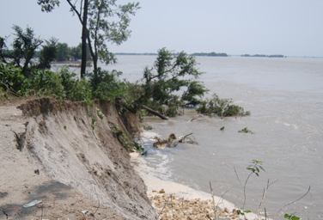
Eastern India
The Embankment Era:
  Permanent Settlement in the Bengal Province
  Flood = curse
  Embankments on the Mahanadi (D’Souza 2002, 2006), Kosi and Gandak Rivers (Mishra 2008)
  colonial zamindars crafted an embankment driven flood control regime (Singh 2011)
  replacement of ‘overflow irrigation’ (Wilcocks 1930; Klingensmith 2007)
  from ‘flood dependent agrarian regime’ to a ‘flood vulnerable landscape’ (D’Souza 2006)
Notes:
Rohan D'Souza's research on the Mahanadi River in Orissa manifest how embankments, designed to insulate lands from inundation, resulted in the silting up of the channels and aggravated floods by raising flood lines to dangerous levels. Embankments, by confining floods within the narrow stretch of the river channel, did not allow the silt to be deposited uniformly over the flood plains, resulting instead in the deposit of silt in the river bed itself. It also deprived flood plains of essential nutrient deposits essential for continued fertility. Low-lying areas remained waterlogged and the pre-existing drainage network was destroyed. Moreover, the constant breaching of embankments leading to more floods caused by the concentrated discharge of water proved to be disastrous. This was a complete departure from the pre-colonial agrarian relations to flood, floodwaters, and sediment in the region, which drew the attention of British civil engineers, such as William Wilcocks, who wrote extensively about the beneficial side of what he understood and categorized as “overflow irrigation.” Daniel Klingensmith investigates the debate among civil engineers, public health officials, academicians, and politicians on the disspitation of large sections of the Bengal delta and the deleterious effects of replacing “overflow irrigation” through the construction of embankments (including railway embankments) on the Damodar. D'Souza, “Colonialism, Capitalism and Nature”. R. D'Souza, Drowned and Dammed: Colonial Capitalism and Flood control in Eastern India (New Delhi: Oxford University Press, 2006).
The scale of devastation could be understood with historical instances including the breaching of the Gandak embankment in Bihar and the inundation of around 30 villages in 1872. Mishra,“The Bihar Flood Story,” 15.
‘Overflow irrigation’ - It was a system by which the nutrient-rich, silt-laden monsoon floodwaters from the upper regions of various rivers flowing into Bengal were distributed evenly over the delta, watering and more importantly fertilizing fields, spreading fish over the countryside and sweeping away the mosquito populations that spread malaria. Floodwater was not allowed to go where it would; rather, it was directed through a system of wide, shallow canals with minimal embankments, in which, at an appropriate time during the yearly monsoon, breaches were made to allow more even flooding. The local water boards which worked with cultivators were in charge of the proper distribution of this water. The canals also drained the land, preventing water-logging. W. Willcocks, Lectures on the Ancient System of Irrigation in Bengal (Calcutta: University of Calcutta, 1930). D. Klingensmith, One Valley and a Thousand: Dams, Nationalism, and Development (USA: Oxford University Press, 2007)

Slide 7
Beyond reductionist generalizations
canals in the northwest became a source of economic dynamism and constant innovation (Stone 1985)
hydraulic engineering projects in the deltas of Cauvery and Godavari Rivers were “less environmentally disruptive or destructive than colonial riparian works of the north and blended more into the environmental and cultural landscape of the respective delta regions” (Schmitthenner 2011: 181)
commercialization and peasant indebtedness were processes that predated colonial regime in the region, and which were integral to the expansion of well irrigation in the west (Hardiman 1998)
Notes:
This has been discussed partially in L. 10 where I had shed light into the debate on ‘precolonial equilibrium’ vs. ‘colonial hydrology’.

Slide 8
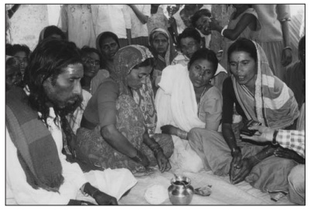
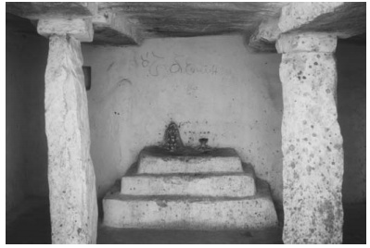
co-existence of ‘modern’ with pre-colonial techniques in western India (Rosin 1993)
village communities were unstable entities driven and shaped by hierarchies (Mosse 1997, 1999, 2003)
folksongs and stories inscribed in popular memory bear testimony to hydrological irregularity, technological vulnerability, and social anxiety (Shah 2008; 2012)
Notes:
Mosse’s ethno-historical work (1997) in Sivagangai and Ramnad districts of Tamil Nadu establishes “a persistent link between systems of caste honour and tank irrigation works in the articulation of authority at the level of village, micro-region and kingdom.”

Slide 9
Watershed: from metabolism to ‘metabolic rift’
the greatest moment of hydraulic transition in India (D’Souza 2006)
the ‘rule of profit’
the era of the ‘scientific management’
      absolute control over flow pattern, distribution, allocation
      cultural dominance of the engineering paradigm
      community replaced by metaphor of machines (stop dams, weirs, etc.)
    colonial legacy during the post-independent period: MPRVDPs
Notes:
pecuniary value - enhance collections through irrigation, navigation, increased land revenue, commercial agriculture
Social, ecological costs
Canal Drainage Act 1873 – limited the number of outlets from each channel; fixed the area to be irrigated
Irrigation department’s control over the outlets
Central control over distribution and supply of water
Community replaced by metaphor of machines (stop dams, weirs, etc.); denial of customary rights of village headmen to control their own water
Water – commodity; water tax, embankment tax imposed to tap river waters
“The water rate was decided not on the basis of an actual demand for it, but instead pitched to realize profits on the capital extended on the project” (D’ Souza, 2002).
Demand created through coercive means; Irrigation Bill of 1876 – ‘illegal irrigation’; between 1883 – 84 – 7, 870 cases filed over 28, 200 acres in the Orissa delta (Canal Commission Report, 1885)
Destruction of all non-canal irrigation sources (bunds, ponds, tanks, lakes, etc.); denial of farmers’ control of and access to rainwater
Water logging, salinity, malaria; the organic relationship lost
Fresh set of proposals - more interventionist
Technological choices should be understood and contextualized within the larger political-economic scenario: embankments to perennial canal system to MPRVD for large scale hydraulic manipulation with advancing capitalism.

Slide 10
References
Agnihotri, I. 1996. “Ecology, Land Use and Colonisation: The Canal Colonies of Punjab,” The Indian Economic and Social History Review 33/1: 37-58.
D'Souza, R. 2002. “Colonialism, Capitalism and Nature: Debating the Origins of Mahanadi Delta’s Hydraulic Crisis (1803-1928).” Economic and Political Weekly 37/13: 1261-72.
D'Souza, R. 2006. Drowned and Dammed: Colonial Capitalism and Flood control in Eastern India. New Delhi: Oxford University Press.
D'Souza, R. 2006a. “Water in British India: The Making of a ‘Colonial Hydrology’.” History Compass 4/4: 621-28.
Gilmartin, D. 1994. “Scientific Empire and Imperial Science: Colonialism and Irrigation Technology in the Indus Basin.”The Journal of Asian Studies 53/4: 1127-48.

Slide 11
References
Hardiman, D. 1998. “Well Irrigation in Gujarat: Systems of Use, Hierarchies and Control.” Economic and Political Weekly 33/25: 1533-44.
Klingensmith, D. 2007. One Valley and a Thousand: Dams, Nationalism, and Development. USA: Oxford University Press.
Mishra, D.K. 2008 Trapped Between the Devil and the Deep Waters – Story of Bihar’s Kosi River. Delhi: People’s Science Institute and SANDRP.
Mosse, D. 1997. “The Symbolic Making of a Common Property Resource: History, Ecology and Locality in a Tank‐irrigated Landscape in South India.” Development and Change 28/3: 467-504.
Mosse, D. 1999. “Colonial and Contemporary Ideologies of ‘Community Management’: The Case of Tank Irrigation Development in South India.”Modern Asian Studies 33/2: 303-338.

Slide 12
References
Mosse, D. 2003. The Rule of Water: Statecraft, Ecology, and Collective Action in South India.New Delhi: Oxford University Press.
Mukherjee, J. 2018. From hydrology to 'hydrosocial': Historiography of waters in India. In J. Caradonna (ed.) Routledge Handbook of History of Sustainability (UK: Routledge).
Rao, E. 2011. “Taming ‘Liquid Gold’ and Dam Technology: A Study of the Godavari Anicut.” In The British Empire and the Natural World: Environmental Encounters in South Asia, edited by D. Kumar, V. Damodaran and R. D’Souza. Oxford and New York: Oxford University Press, 2011.
Rosin, R.T. 1993. “The Tradition of Groundwater Irrigation in Northwestern India.” Human Ecology 21/1: 51-83.

Slide 13
References
Schmitthenner, P. 2011. “Colonial Hydraulic Projects in South India: Environmental and Cultural Legacy.” In The British Empire and the Natural World: Environmental Encounters in South Asia, edited by D. Kumar, V. Damodaran and R. D’Souza. Oxford and New York: Oxford University Press.
Shah, E. 2008. “Telling Otherwise: A Historical Anthropology of Tank Irrigation Technology in South India.” Technology and Culture 49/3: 652-674.
Shah, E. 2012. “Seeing Like a Subaltern: Historical Ethnography of Pre-modern and Modern Tank Irrigation Technology in Karnataka, India.” Water Alternatives 5/2: 507-538.
Singh, P. 2011. “Flood Control for North Bihar: An Environmental History from the 'Ground-Level' (1850–1954).” In The British Empire and the Natural World: Environmental Encounters in South Asia, edited by D. Kumar, V. Damodaran and R. D’Souza. Oxford and New York: Oxford University Press.

Slide 14
References
Stone, I. 1885. Canal Irrigation in British India: Perspectives on Technological Change in a Peasant Economy. Cambridge: Cambridge University Press.
Weil, B. 2006. “The Rivers Come: Colonial Flood Control and Knowledge Systems in the Indus Basin, 1840s-1930s.” Environment and History 12/1: 3-29.
Whitcombe, E. 1972. Agrarian Conditions in Northern India: The United Provinces under the British Rule, 1860-1900, vol. 1. Berkeley: California University Press.
Willcocks, W. 1930. Lectures on the Ancient System of Irrigation in Bengal. Calcutta: University of Calcutta.

